Slide 1
Social Media Dashboard
Graduation project

Slide 2




Team Members
ENG/Seif Mohamed
ENG/Fares Mohamed ENG/Seif Wael

Slide 3
Introduction
This React-based Reddit User Dashboard lets users search any Reddit username and view public profile data. It displays total karma, account age, top post, top comment, and a karma pie chart using Chart.js. Users can log in via a Firebase- authenticated login form. The app also features a contact form powered by EmailJS, allowing users to send messages directly from the frontend

Slide 4
Main Features
The dashboard provides comprehensive analytics through an interactive interface. Users can enter any Reddit username to view detailed statistics, including account information, karma distribution, and top-performing posts and comments. The platform features real-time data visualization with interactive charts, making it easy to understand user performance at a glance, The

Slide 5
Technical Implementation
Frontend:
Built with React.js
Bootstrap for responsive layout and styling
useState and useEffect for state and lifecycle handling Chart.js for visualizing post vs. comment karma
APIs & Services:
Reddit Public API to fetch user data, top post, and top comment EmailJS to handle contact form submissions without a backend Firebase Authentication for secure login and user session handling
Data Handling:
Fetch and parse JSON data from Reddit API
Identify and display top comment/post based on upvotes Display user info and karma breakdown dynamically

Slide 6
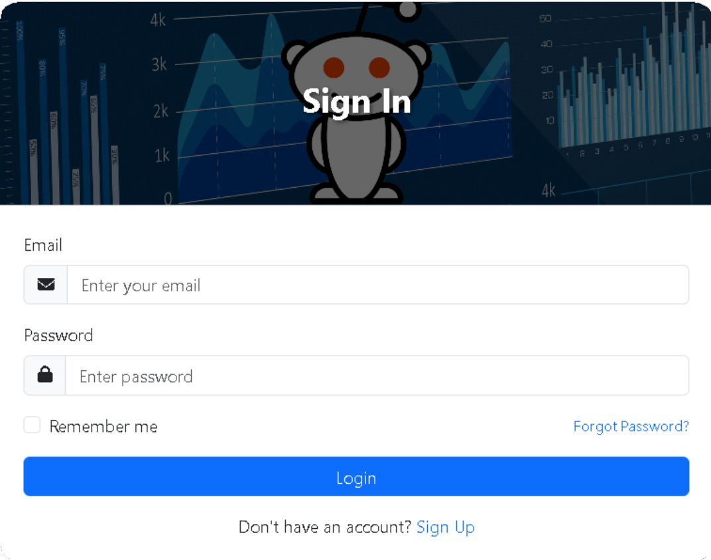
login,signup Forms
The Social Media Dashboard implements Firebase Authentication to provide secure and reliable user authentication. The login form integrates with Firebase to handle user sign-in, ensuring a robust and secure authentication process.
The implementation uses Firebase's email and password authentication method. When a user enters their credentials, the form submits the email and password to Firebase's authentication service. Firebase then verifies the credentials against its secure database, ensuring that only authorized users can access the dashboard.
The login process includes proper error handling, displaying clear messages for invalid credentials or network issues.. Additionally, there's a "Forgot Password" link that triggers Firebase's password reset functionality, sending a reset email to the user's registered address.
The integration with Firebase provides several benefits:
Secure authentication Real-time validation
Password reset functionality Session management

Slide 7
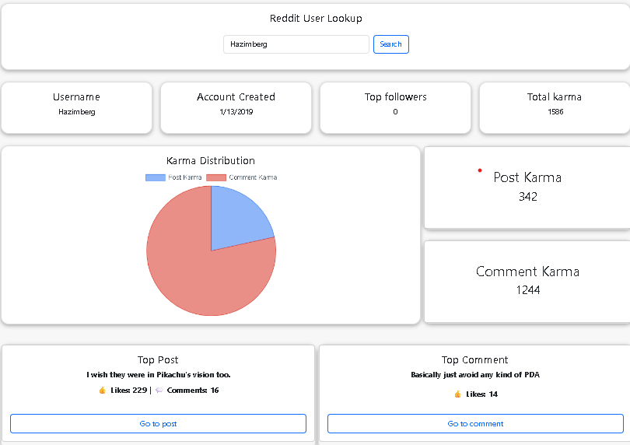
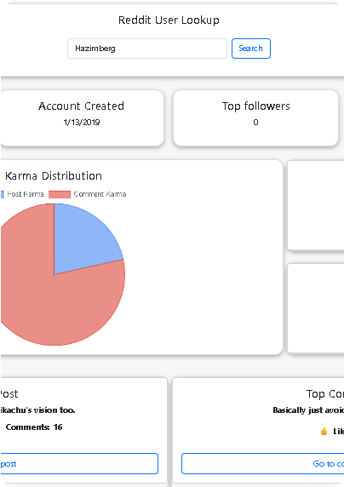
DashBoard
Reddit User Lookup
This dashboard provides a quick and easy way to look up information about a specific Reddit user. By entering a Reddit username, you can access key details about their account activity and engagement.
Main Features:
social media dashboard that allows users to search for any Reddit username and view detailed public data including:
Username info
Account creation date Karma statistics
Top post and comment
Karma distribution chart
Technologies Used
React.js
Bootstrap (for layout and responsiveness) Chart.js (for pie chart)
Reddit API (for fetching user data)

Slide 8
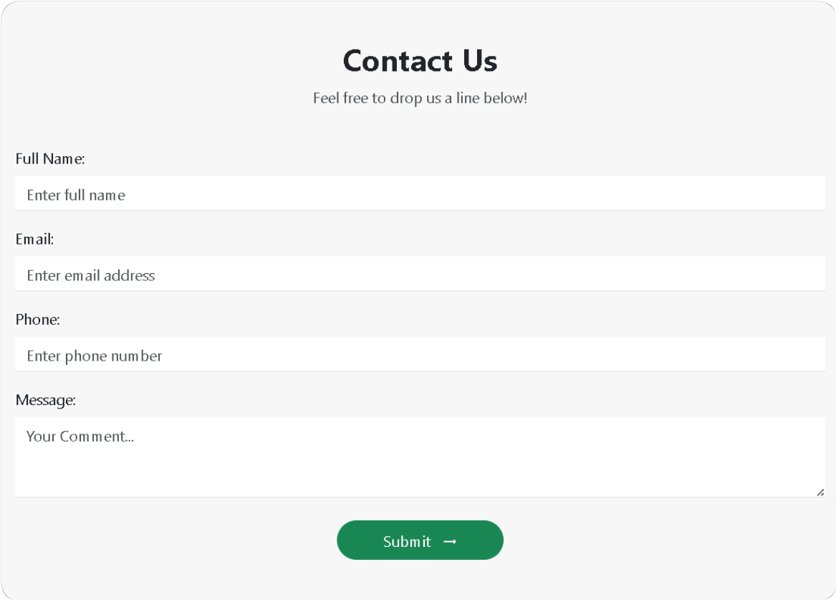
Contact Form
OverView
For websites requiring contact forms without the complexities of server-side email handling, EmailJS offers a streamlined solution. Email sending is enabled directly from the website's front- end through the use of JavaScript. This eliminates the necessity for developing and maintaining backend code specifically for email transmission.
Key Features:
Email Sending on the Client-Side: The fundamental capability involves emails being sent directly from the user's browser.
Simplified Integration: By including the provided JavaScript library in the HTML and implementing minimal JavaScript code, forms can be easily connected.

Slide 9
Conclusion
This project uses Firebase for secure login/signup, the Reddit API for user data (karma, top posts), and EmailJS for direct contact form submissions. By integrating these specialized external services, the application streamlines development, focusing on the frontend experience while minimizing backend complexity for authentication, data retrieval, and user communication.

Slide 10


Thank you

